Slide 1
Water, the environment and us
Libby Ranzetta, Bury Water Meadows Group

Slide 2
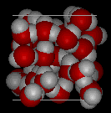
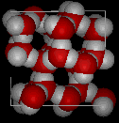
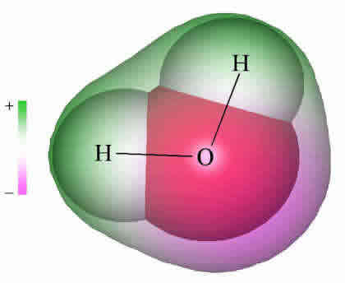
What is water and what’s so special about it?

Slide 3
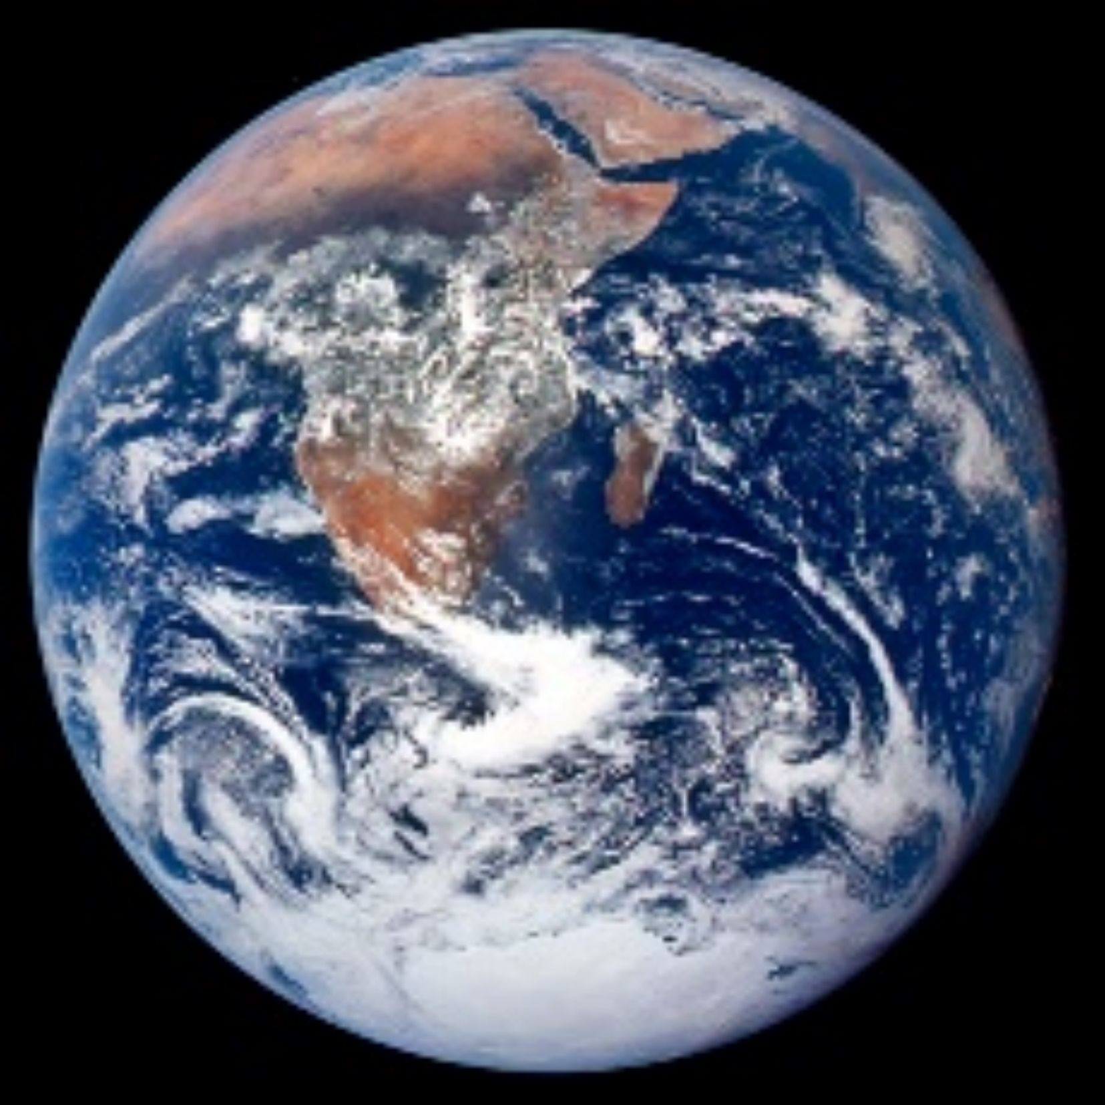
Where does water comes from?

Slide 4
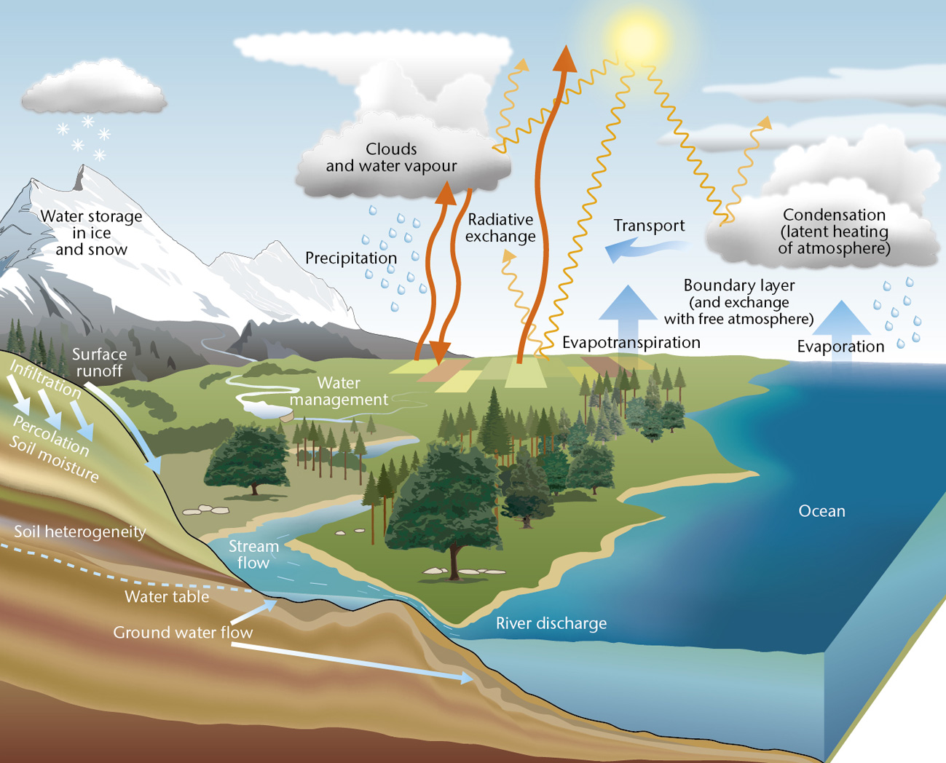
The water cycle

Slide 5
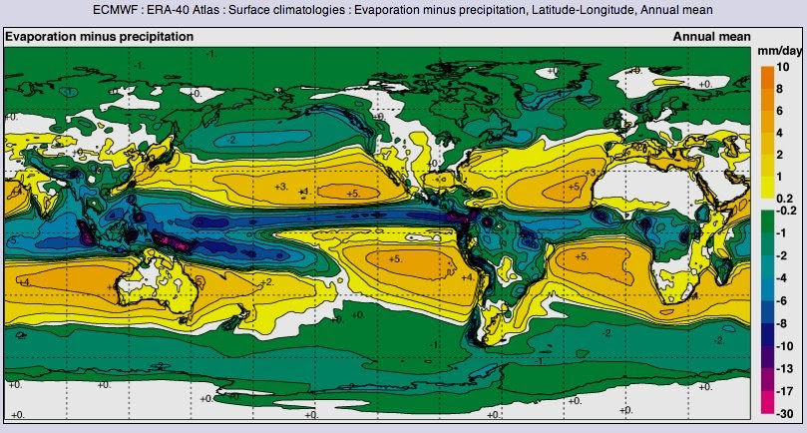

Slide 6
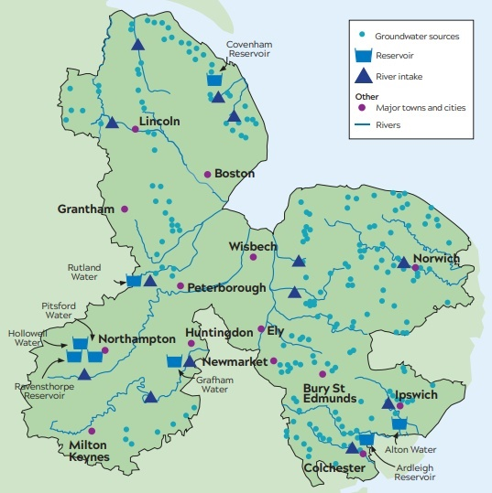
Where does our tap water come from?
Anglian Water: “We borrow water from the environment, store it and treat it to world-class standards to supply safe drinking water to 4.3 million of you across the region.”

Slide 7
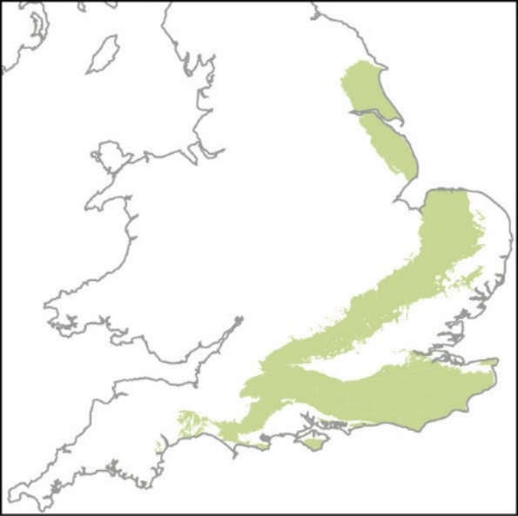
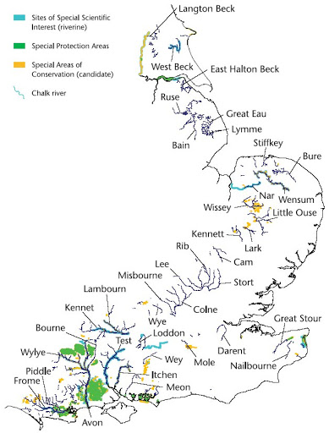
The Chalk

Slide 8
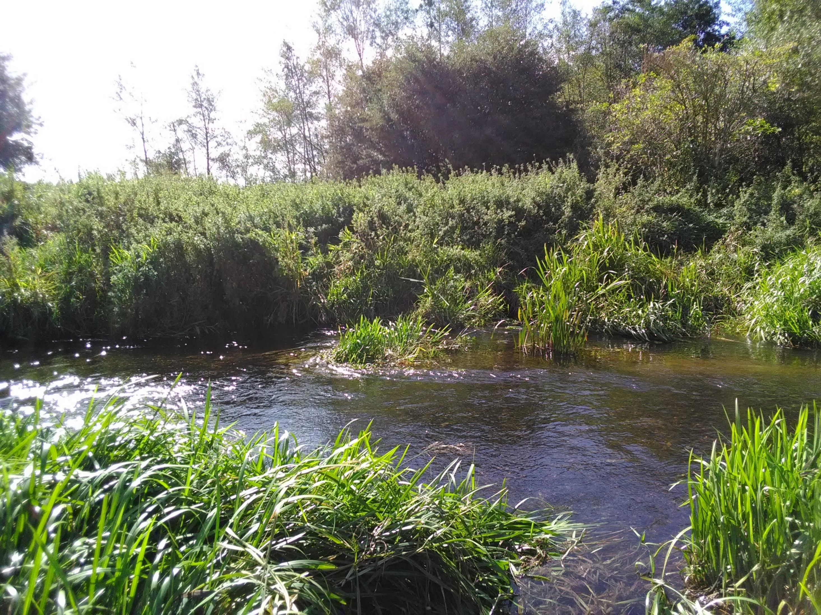
Chalk streams

Slide 9
Supply and demand
Anglian Water:
“We face four pressing and interlinked challenges – climate change, environmental protection, population growth and the risk of drought.
We have to act now or we will move from a strong position of a surplus of 150 million litres of water daily to a deficit of 30 million litres daily by 2025.”

Slide 10
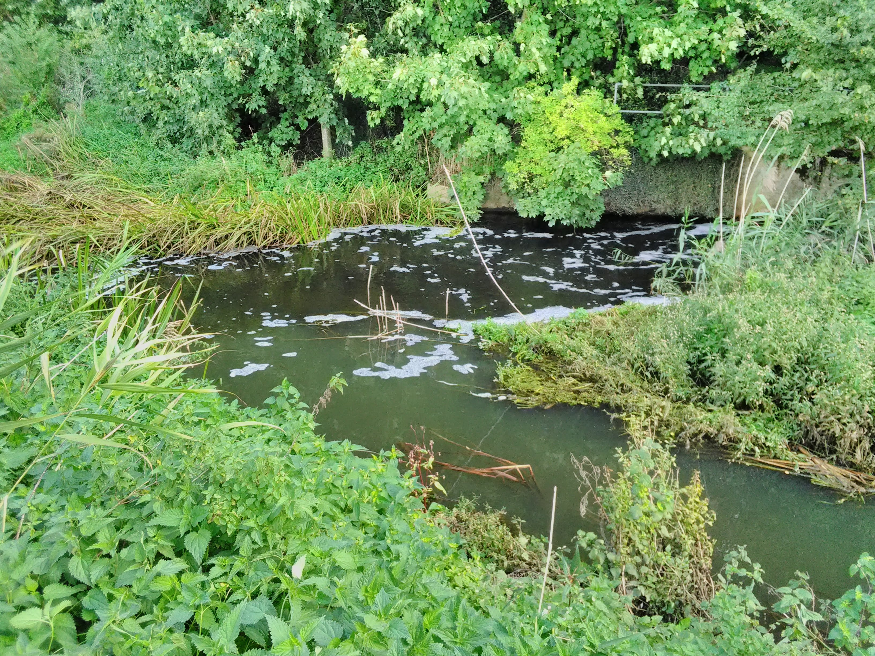
Pollution

Slide 11
More sustainable use of water
In general
Use only non-polluting products
In the kitchen
Fix a washer to that leaky tap and save up to 3 litres a day
Wash 1 full load in your washing machine instead of 2 half loads, and save 10 litres
A running tap uses 15 litres every minute - try washing your fruit and vegetables in a bowl of fresh water
Fill up your dishwasher before putting it on. Dishwashers use around 15 litres of water with every wash.
… wash your dishes by hand

Slide 12
In the bathroom
Turn the tap off between rinses when brushing your teeth and save 60 litres per day per household
Use a water displacement device in your toilet cistern and save 1 to 2 litres with every flush
Shower for 60 seconds less each day and save 15 litres per minute.
…don’t shower every day! (and baths use c.80 litres)
…save your shower and bath water for the garden or flushing the toilet
In the garden
Use a watering can instead of a hosepipe to water the garden and save 225 litres of water in 15 minutes
Collect rainwater in a water butt to use in your garden
Cover soil with pebbles, gravel or chipped bark to keep moisture in and weeds out
Let the grass grow and set your mower on a higher setting to keep the moisture in

Slide 13
Finally
Love your rivers
Chalk Aquifer Alliance – chalkaquiferalliance.org
River lark Catchment Partnership – riverlark.org.uk
Bury Water Meadows Group – burywatermeadowsgroup.org.uk

